Slide 1
The Importance of AgriBusiness to the St. Louis Economy
Prepared by the St. Louis Agribusiness Club Summer 2020 University of Missouri Extension | Exceed

Slide 2
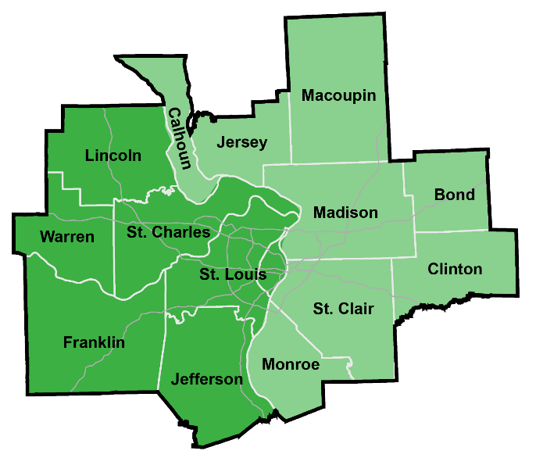
St. Louis Metro Region
The St. Louis Metropolitan Statistical Area (MSA) is a bi-state region that covers 14 counties and one city.
St. Louis MSA Economy Statistics:
$179 Billion in GDP
(Gross Domestic Product)
1,784,000 in Total Employment
(Full- and Part-Time Employment)
Source: 2018 IMPLAN data based on U.S. Bureau of Economic Analysis metropolitan figures. GDP adjusted to 2020 dollars.

Slide 3
St. Louis AgriBusiness: What is it?
AgriBusiness is a broad term encompassing all aspects of agricultural production, processing and related inputs/services
Producers
Crop Farming
Animal Farming
Forestry
Fishing
Agriculture/Forestry Support
(Management, Harvesting, etc.)
Processing
Animal Processing
Beverage Manufacturing
Dairy Manufacturing
Food Manufacturing
Wood Product Manufacturing
Apparel/Textile Manufacturing
Inputs/Services
Scientific Research
Veterinary Services
Agric. Chemical/Pharmaceutical Mfg.
Farm Machinery Manufacturing
Food Processing Machinery Mfg.
Wholesalers & Transportation

Slide 4
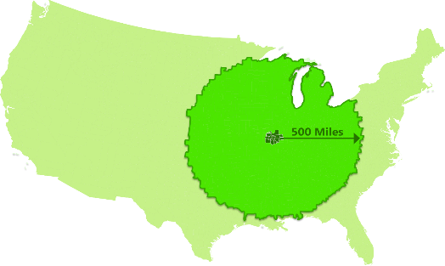
St. Louis AgriBusiness: Production Central
58% of U.S. Farms & Producers are within
500 Miles of the St. Louis Metro
Regional Statistics
Within 500 Miles of St. Louis Metro:
58% of U.S. Farms & Producers
51% of U.S. Agricultural Production
St. Louis Metro has:
18,478 Farm Producers
11,057 Farms covering 2.8 million acres
$17.1 Billion in farm land & building value
$93.5 Million in hired farm payroll
Source: U.S. 2017 Census of Agriculture

Slide 5
St. Louis Production Agriculture
grows crops and timber, raises animals, and harvest the food and fiber for selling directly to consumers or for processing
Description | Jobs | Labor Income | GDP | Gross Sales
Production Agriculture | 13,530 | $231M | $499M | $1.6B
Crop Production
6,398 Jobs
$1.1B Gross Sales
Animal Production
4,952 Jobs
$406M Gross Sales
Other Prod./Support
2,180 Jobs
$72M Gross Sales
The state of Missouri ranks:
2nd in Total Farms
6th in Soybean Sales
7th in Pig Sales
The state of Illinois ranks:
1st in Soybean Sales
2nd in Corn Sales
4th in Pig Sales
Notes: In 2020 Dollars. M for millions, B for billions. GDP is Gross Domestic Product. Numbers may not sum due to rounding. Rankings from U.S. 2017 Census of Agriculture

Slide 6
St. Louis Agricultural Processors
turn farm and forest outputs into food, beverage, paper and other products sold around the world
Description | Jobs | Labor Income | GDP | Gross Sales
Processing Manufacturers | 21,388 | $1.6B | $3.8B | $12.9B
Food & Beverage Manufacturing
14,869 Jobs
$10.7B Gross Sales
Fiber & Forest Product Manufacturing
6,518 Jobs
$2.1B Gross Sales
Some of the St. Louis Area’s Largest AgriBusiness Employers
Notes: In 2020 Dollars. M for millions, B for billions. GDP is Gross Domestic Product. Numbers may not sum due to rounding.

Slide 7
St. Louis AgriBusiness Inputs & Services
provide the science, machinery, distribution, and inputs to agricultural producers, processors, and related industries
Description | Jobs | Labor Income | GDP | Gross Sales
Inputs & Services | 49,185 | $3.6B | $5.8B | $14.1B
Ag./Pharm. Mfg. & Research
9,289 Jobs
$6.9B Gross Sales
Distribution/Wholesalers
22,034 Jobs
$5.3B Gross Sales
Other Inputs/Services
17,862 Jobs
$1.8B Gross Sales
Some of the St. Louis Area’s Largest AgriBusiness Employers
Notes: In 2020 Dollars. M for millions, B for billions. GDP is Gross Domestic Product. Numbers may not sum due to rounding.

Slide 8
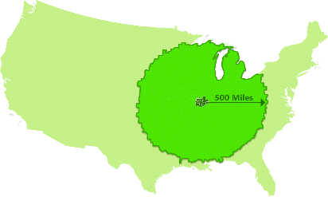
St. Louis AgriBusiness Specializations
St. Louis has a long history as a center of AgriBusiness, with over
50% of agricultural production within 500 miles of the metro area
That history, and continuing innovation as an AgriBusiness hub, is shown through the industry specializations and institutions found here
Non-Profits/Institutions
foster innovation:
Danforth Center
MO Botanical Garden
Washington University
University of Missouri
St. Louis University
St. Louis Comm. College
Farm Associations
39 North District
St. Louis Metro AgriBusiness Employment Specializations
2.8X more specialized in employment for Animal Food Manufacturing
2.0X more specialized in employment for Basic Chemical Manufacturing
1.9X more specialized in employment for Beverage Manufacturing
1.6X more specialized in employment for Paper Product Manufacturing
1.5X more specialized in employment for Pharmacy/Medicine Manufacturing
Notes: Specialization in 2019 employment from location quotient analysis that compares St. Louis MSA industry employment with U.S. averages. Source: EMSI Developer

Slide 9
St. Louis AgriBusiness: Direct Impact
Description | Jobs | Labor Income | GDP | Gross Sales
Direct AgriBusiness | 84,103 | $5.5B | $10.2B | $28.5B
Production Agriculture | 13,530 | $231M | $499M | $1.6B
Processing Manufacturers | 21,388 | $1.6B | $3.8B | $12.9B
Inputs & Services | 49,185 | $3.6B | $5.8B | $14.1B
Definitions
Jobs: Annual average full- or part-time jobs
Labor Income: Worker wages, benefits, and owner pay
GDP: Gross Domestic Product or the total market value of final goods or services
Gross Sales: Total value of all sales and equal to GDP plus intermediate sales
Notes: In 2020 Dollars. M for millions, B for billions. GDP is Gross Domestic Product. Numbers may not sum due to rounding.

Slide 10
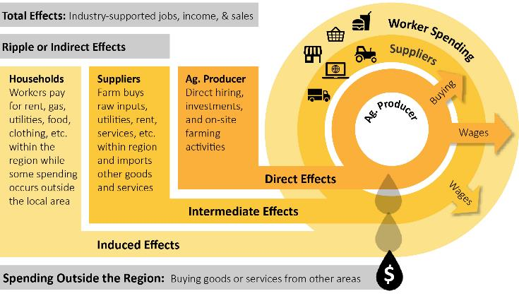
St. Louis AgriBusiness: Larger Contribution
AgriBusiness sales ripples through the St. Louis economy to benefit other businesses and workers as illustrated through spending flows from an Agricultural Producer:
Direct AgriBusiness Activity
Jobs Income Sales
84,103 $5.5B $28.5B
Spurs Supplier (Intermediate) purchases and Household (Induced) spending
for a larger economic contribution or
Total Impact

Slide 11
St. Louis AgriBusiness: Total Impact
Description | Jobs | Labor Income | GDP | Gross Sales
Direct AgriBusiness | 84,103 | $5.5B | $10.2B | $28.5B
Supplier Spending | 35,798 | $2.5B | $4.1B | $7.5B
Household Spending | 46,732 | $2.3B | $4.2B | $7.1B
Total AgriBusiness Impact | 166,633 | $10.3B | $18.4B | $43.1B
Percent of St. Louis MSA | 9.3% | 9.2% | 10.3% | 12.8%
Total Tax Contributions $3.46B
State & Local Taxes $1.33B
Federal Taxes $2.13B
Notes: In 2020 Dollars. M for millions, B for billions. GDP is Gross Domestic Product. Numbers may not sum due to rounding. Annual tax estimate from IMPLAN uses U.S. Census state and federal tax collection data and do not capture unique situations such as tax abatements/exemptions so should be considered a broader measure. Source: IMPLAN

Slide 12
St. Louis AgriBusiness: Economic Contribution
$43 Billion in AgriBusiness and additional indirect supply chain/household sales
13 Percent of St. Louis MSA total sales is represented by AgriBusiness and indirect sales
166,600 Jobs
84,100 AgriBusiness Jobs
Description Jobs
Production Agriculture 13,500
Processing 21,400
Inputs/Services 49,200
82,500 Indirect Jobs from Supplier and Household Spending
Description Jobs
Retail Services 9,100
Health Care 8,500
Administrative Support 8,500
Restaurants 7,600
Professional/Technical Services 7,600
Personal & Family Service 6,400
Real Estate/Rental/Leasing 6,400
Description Jobs
Finance & Insurance 5,600
Other Transportation 3,600
Company Management 3,200
Other Wholesale Trade 3,100
Mechanical Repair/Maintenance 2,800
Arts/Entertainment/Recreation 2,100
All Other Industries 8,100
Notes: In 2020 Dollars. Numbers may not sum due to rounding. Source: IMPLAN

Slide 13
OUR MISSION To promote the positive impact of the agricultural industry in the Greater St. Louis region through educational, networking and professional development opportunities
www.StLouisAgClub.org

