Slide 1
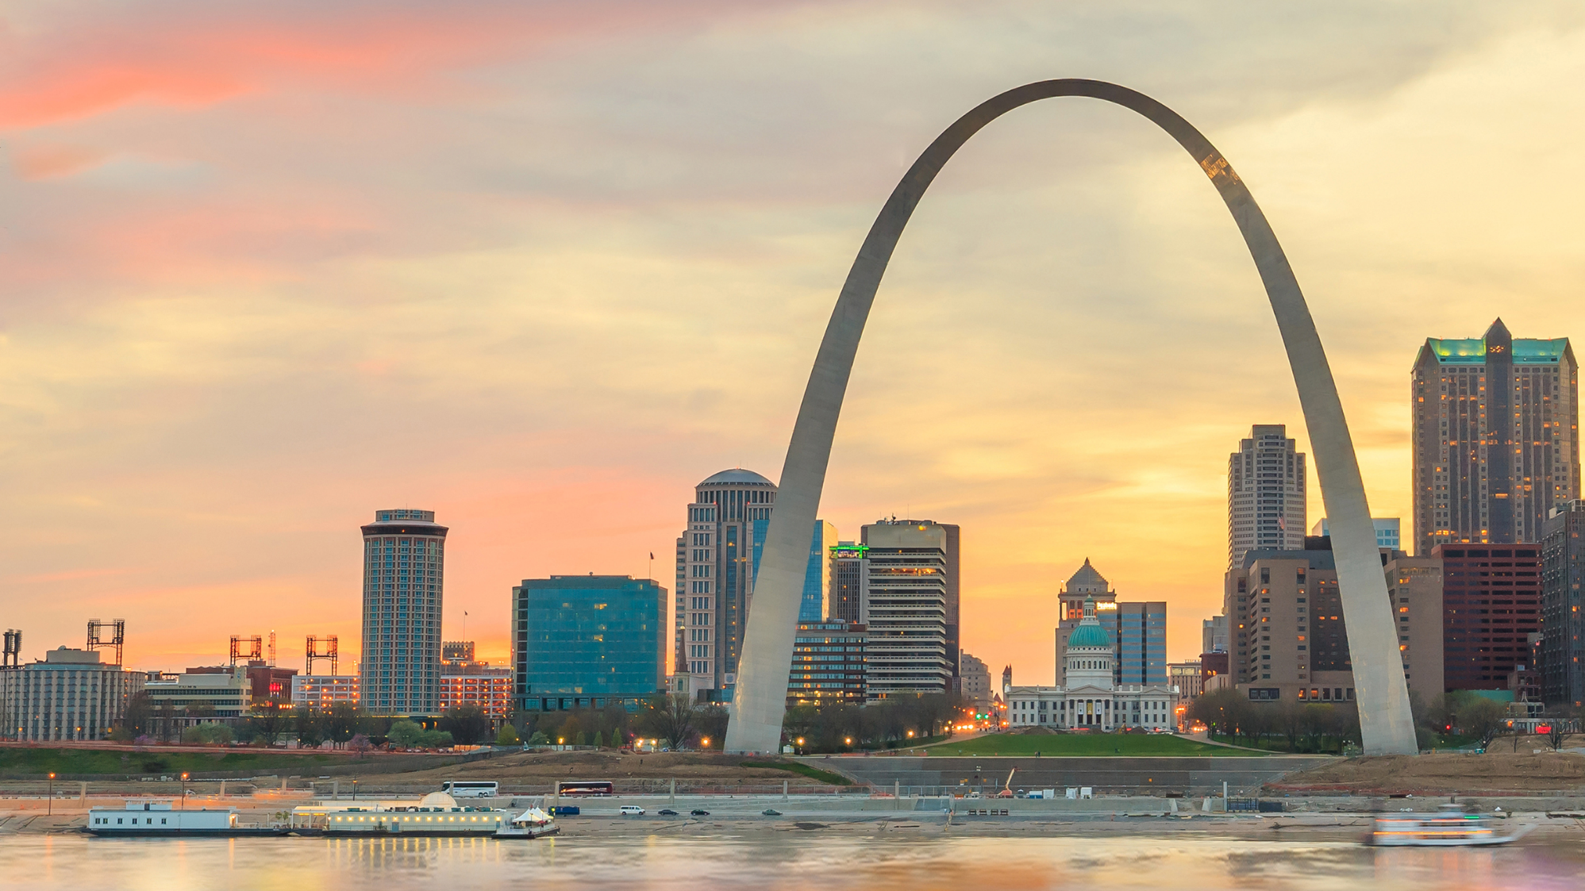
The Importance of AgriBusiness to the St. Louis Economy
Prepared by the St. Louis Agribusiness Club University of Missouri Extension | Exceed 2025

Slide 2

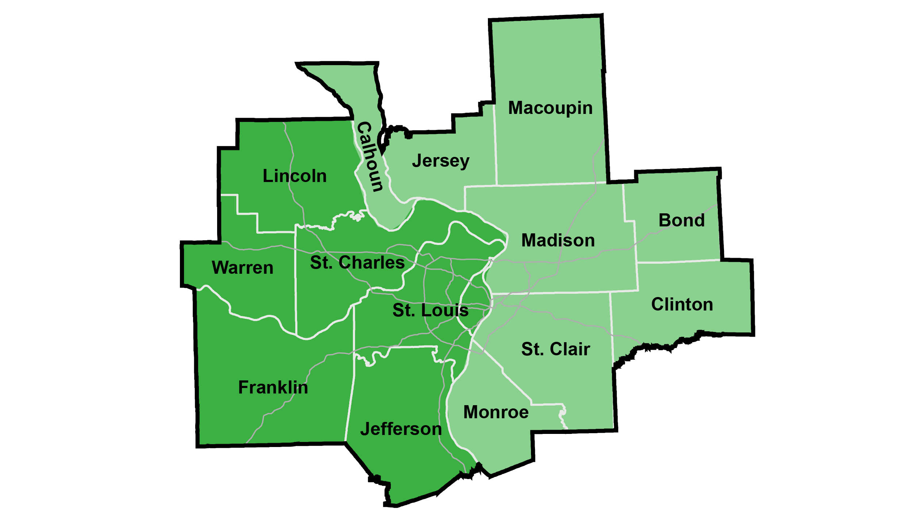
St. Louis Metro Region
The St. Louis Metropolitan Statistical Area (MSA) is a bi-state region that covers 14 counties and one city.
The St. Louis MSA Economy:
$238 Billion GDP
1,884,000 Jobs
Sources and notes: 2023 IMPLAN data based on U.S. Bureau of Economic Analysis metropolitan figures. All full- and part-time jobs. GDP adjusted to 2025 dollars.

Slide 3




St. Louis AgriBusiness: What is it?
AgriBusiness is a broad term encompassing all aspects of agricultural production, processing and related inputs/services
Producers
Crop Farming
Animal Farming
Forestry
Fishing
Agriculture/Forestry Support
Processing
Animal Processing
Beverage Manufacturing
Dairy Manufacturing
Food Manufacturing
Wood Product Manufacturing
Apparel/Textile Manufacturing
Inputs/Services
Scientific Research
Veterinary Services
Agric. Chemical/Pharmaceutical Mfg.
Farm Machinery Manufacturing
Food Processing Machinery Mfg.
Wholesalers & Transportation

Slide 4
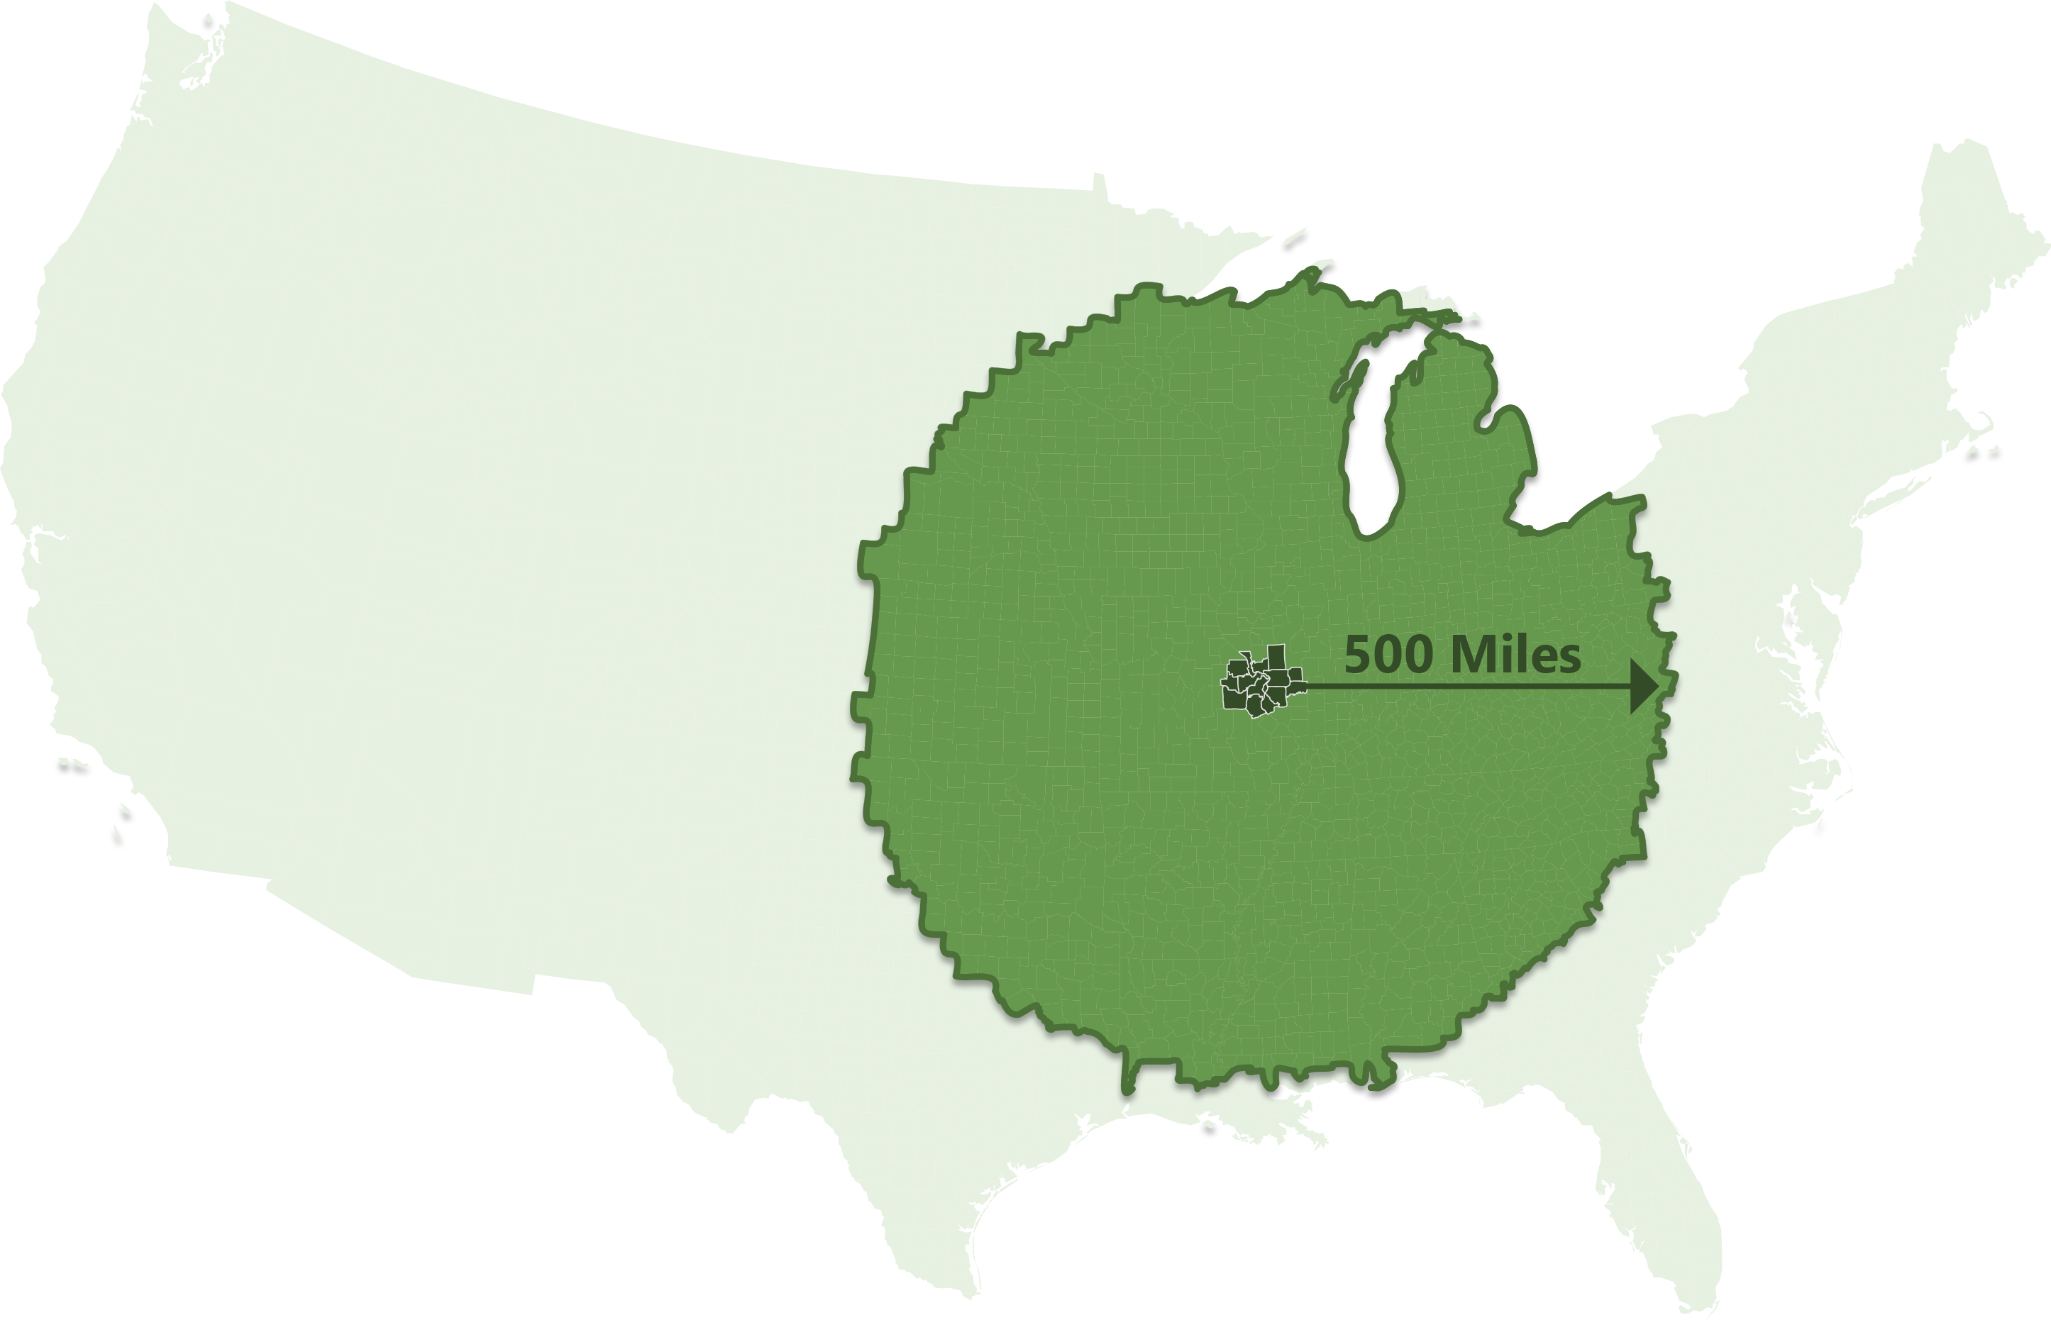
St. Louis AgriBusiness: Production Central
Regional Statistics
Within 500 Miles of St. Louis Metro:
48% of U.S. Farms
46% of U.S. Agricultural Production
49% of U.S. Poultry Sales
72% of U.S. Hog Inventories
78% of U.S. Corn Production
81% of U.S. Soybean Production
St. Louis Metro has:
19,376 Farm Producers
10,584 Farms covering 2.8 million acres
48%
of U.S. Farms are within
500 Miles
of the St. Louis Metro
Source: U.S. 2022 Census of Agriculture

Slide 5
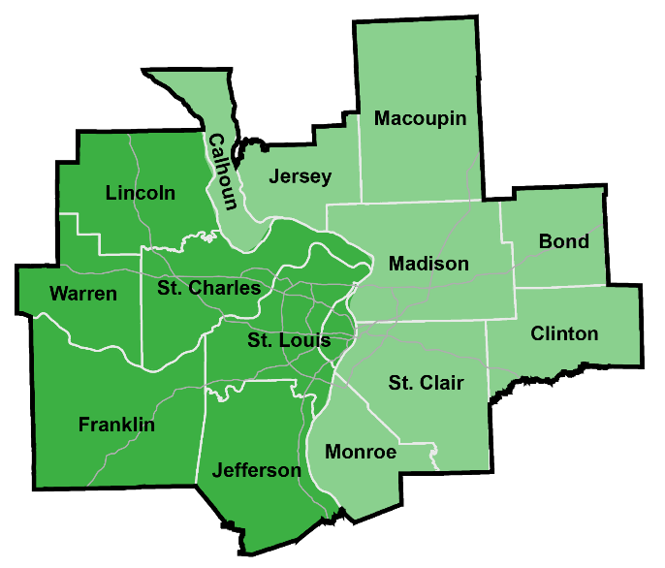
St. Louis AgriBusiness Specializations
St. Louis has a long history as a center of AgriBusiness, with
major companies and institutions located in the region
That history, and continuing AgriBusiness innovation, is shown through the industry specializations found here:
Non-Profits/Institutions:
Danforth Plant Science Center
Missouri Botanical Garden
University of Missouri
University of Illinois
St. Louis University
St. Louis Community College
Southern Illinois Universities
Washington University
39 North District
BioSTL
St. Louis Metro AgriBusiness Job Specializations
3.4X more specialized in jobs for Animal Food Manufacturing
1.9X more specialized in jobs for Agric. Chemical Manufacturing
1.8X more specialized in jobs for Basic Chemical Manufacturing
1.6X more specialized in jobs for Beverage Manufacturing
1.3X more specialized in jobs for Pharmaceutical Manufacturing
Notes: Specialization in 2024 employment from location quotient analysis that compares St. Louis MSA industry employment with U.S. averages. Source: Lightcast

Slide 6
St. Louis Production Agriculture
grows crops and timber, raises animals, and harvest the food and fiber for selling directly to consumers or for processing
Description | Jobs | GDP
Production Agriculture | 15,807 | $1.4B
Crop Production
8,364 Jobs
$1.05B GDP
Animal Production
4,803 Jobs
$264M GDP
Other Prod./Support
2,640 Jobs
$88M GDP
The state of Missouri ranks:
2nd in Total Farms
7th in Soybean Sales
7th in Poultry Sales
The state of Illinois ranks:
1st in Soybean Sales
2nd in Corn Sales
4th in Pig Sales
Notes: In 2025 Dollars. M for millions, B for billions. GDP is Gross Domestic Product. Numbers may not sum due to rounding. Rankings from U.S. 2022 Census of Agriculture

Slide 7



St. Louis Agricultural Processors
turn farm and forest outputs into food, beverage, paper and other products sold around the world
Description | Jobs | GDP
Processing Manufacturers | 21,828 | $4.7B
Food & Beverage Manufacturing
15,801 Jobs
$3.85B GDP
Fiber & Forest Product Manufacturing
6,027 Jobs
$818M GDP
Notes: In 2025 Dollars. M for millions, B for billions. GDP is Gross Domestic Product. Numbers may not sum due to rounding.

Slide 8



St. Louis AgriBusiness Inputs & Services
provide the science, machinery, distribution, and inputs to agricultural producers, processors, and related industries
Description | Jobs | GDP
Inputs & Services | 55,572 | $9.2B
Ag./Pharm. Mfg. & Research
16,515 Jobs
$3.7B GDP
Distribution/Wholesalers
23,611 Jobs
$4.2B GDP
Other Inputs/Services
15,446 Jobs
$1.3B GDP
Notes: In 2025 Dollars. M for millions, B for billions. GDP is Gross Domestic Product. Numbers may not sum due to rounding.

Slide 9
St. Louis AgriBusiness: Direct Impact
Description | Jobs | GDP
Direct AgriBusiness | 93,207 | $15.2B
Production Agriculture | 15,807 | $1.4B
Processing Manufacturers | 21,828 | $4.7B
AgriBusiness Inputs & Services | 55,572 | $9.2B
Notes: In 2025 Dollars. M for millions, B for billions. GDP is Gross Domestic Product. Numbers may not sum due to rounding.

Slide 10
St. Louis AgriBusiness: Total Impact
Description | Jobs | GDP
Direct AgriBusiness | 93,207 | $15.2B
Indirect Spending: Suppliers & Workers | 82,882 | $10.5B
Total AgriBusiness Impact | 176,088 | $25.7B
Percent of St. Louis MSA | 9.3% | 10.8%
Total Tax Contributions $4.9B
State & Local Taxes $1.7B
Federal Taxes $3.2B
Notes: In 2025 Dollars. M for millions, B for billions. GDP is Gross Domestic Product. Numbers may not sum due to rounding. Annual tax estimate from IMPLAN uses U.S. Census state and federal tax collection data and does not capture unique situations such as tax abatements/exemptions, so should be considered a broader measure. Source: IMPLAN

Slide 11

St. Louis AgriBusiness: 5 Years of Growth
St. Louis Agribusiness direct employment has increased significantly:
9,100 more jobs in five years or,
10.8% growth in Agribusiness jobs versus 5.9% for all St. Louis MSA jobs.
Top AgriBusiness Growth Industries over 5 Years:
1,600 more jobs in Scientific Research & Development
1,400 more jobs in Landscape Services
1,350 more jobs in Oilseed Farming
1,100 more jobs in Grocery and Related Wholesalers
800 more jobs in Grain Farming
St. Louis Agribusiness’s total economic contribution is:
$25.7 Billion in Gross Domestic Product or,
10.8% of St. Louis MSA GDP, up from 10.3% in 2019.
Source: Lightcast and IMPLAN figures for 2019 and 2024.

Slide 12
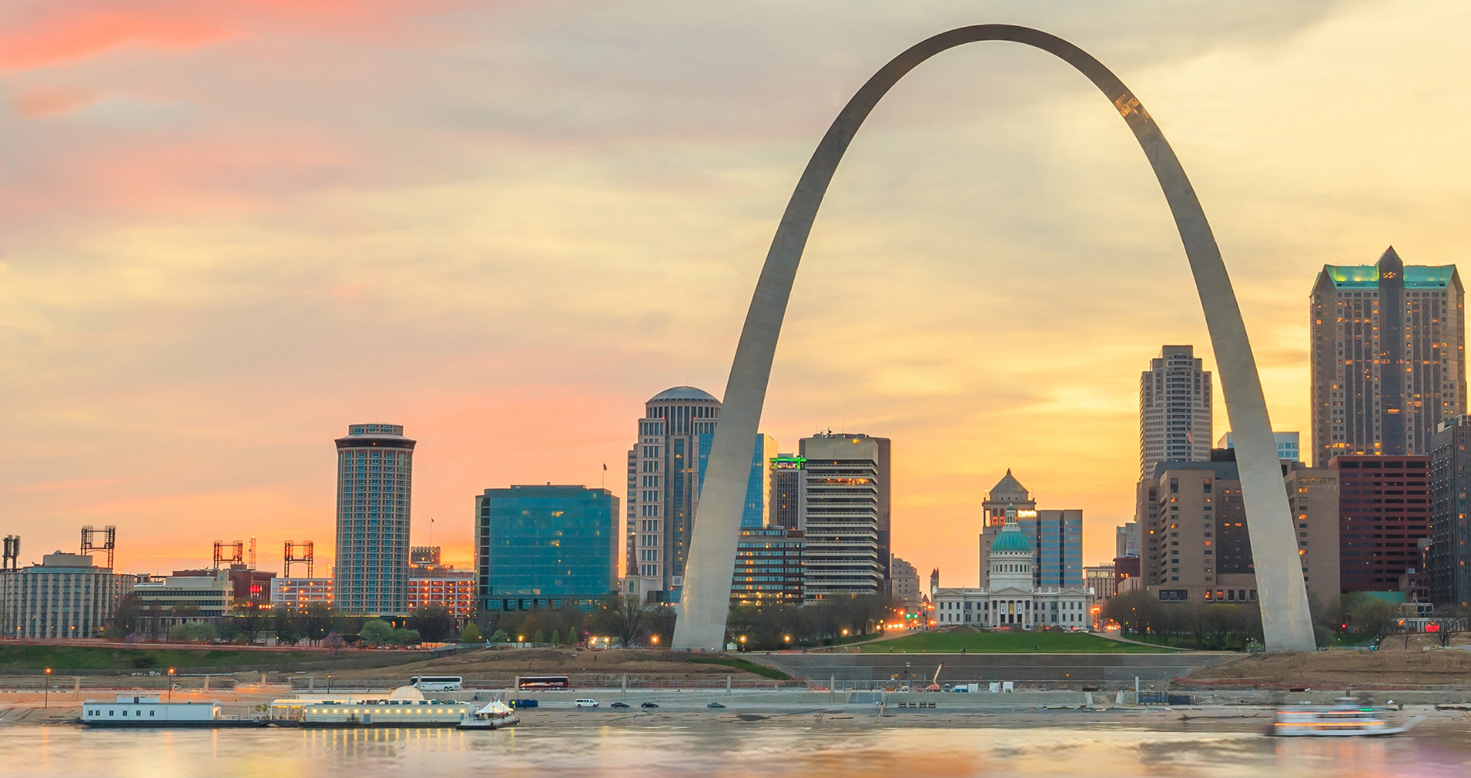

OUR MISSION To promote the positive impact of the agricultural industry in the Greater St. Louis region through educational, networking and professional development opportunities
www.StLouisAgClub.org

